Slide 1

Identification and preliminary analysis of hub genes associated with bladder cancer progression by comprehensive bioinformatics analysis¹ Han Wang, Junjie Liu, Yanyan Lou, Yang Liu, Jieqing Chen, Xinhui Liao, Xiuming Zhang, Chengzhi Zhou, Hongbing Mei & Aifa Tang, Scientific Reports, 2024
Presentation by Adam Cankaya acankaya2017@fau.edu Florida Atlantic University Department of Electrical Engineering and Computer Science COT 6900 Independent Study, Summer 2024

Slide 2

Brief Summary of original paper
Goal – identify differentially expressed genes (DEGs) between cancer and normal bladder tissue, focus on association with prognosis
Input – mRNA expression profiles from TCGA and GEO databases
Methods – weighted gene co-expression networks and pathway enrichment analysis
Results – ~3700 DEGs identified. CDH19, RELN, PLP1, and TRIB3 potential biomarkers for bladder cancer prognosis

Slide 3
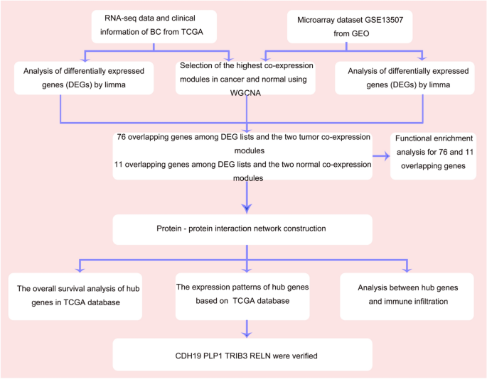
Workflow

Slide 4
Workflow
1) RNA profiles of cancerous and normal bladder tissue

Slide 5
Workflow
1) RNA profiles of cancerous and normal bladder tissue
2) R packages identify DEGs between normal and tumor

Slide 6
Workflow
1) RNA profiles of cancerous and normal bladder tissue
2) R packages identify DEGs between normal and tumor
3) R packages identify DEGs with biological relevance

Slide 7
Workflow
1) RNA profiles of cancerous and normal bladder tissue
2) R packages identify DEGs between normal and tumor
3) R packages identify DEGs with biological relevance
4) Online tools to visualize hub genes and construct protein-protein interaction network

Slide 8
Workflow
1) RNA profiles of cancerous and normal bladder tissue
2) R packages identify DEGs between normal and tumor
3) R packages identify DEGs with biological relevance
4) Online tools to visualize hub genes and construct protein-protein interaction network
5) Online tools to verify prognostic value, protein expression levels, and immune infiltration levels of hub genes

Slide 9
Original paper - Step 1 – RNA profile data
The Cancer Genome Atlas – TCGA
Data from 414 BC samples, 19 normal tissue samples
Data covers 14,830 genes (genes with count per million > 1)
Gene Expression Omnibus – GEO
Data from 165 BC samples, 9 normal tissue samples
Data covers 24,324 genes

Slide 10
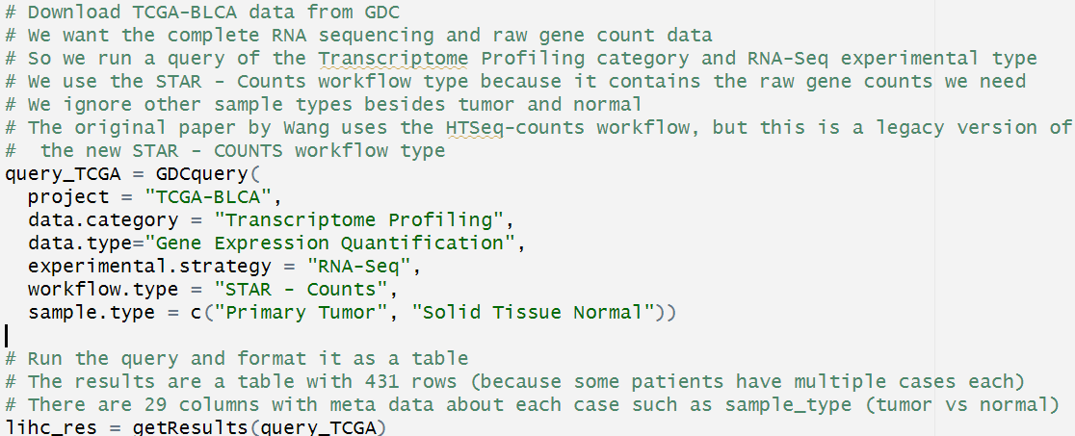
Adam’s work - Step 1 – RNA profile data
Only using the latest TCGA-BLCA data (no GEO)…covering 431 cases total - 412 tumor, 19 normal
Notes:
Not using GEO yet
TCGA-BLCA has 60k genes total, but after filtering for cpm > 1 there are 14k left.
Original raw data is 60600 rows and 431 columns.
Additonal clinical data objects

Slide 11
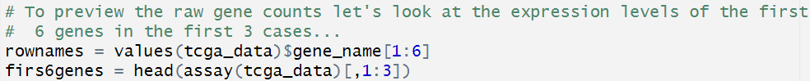
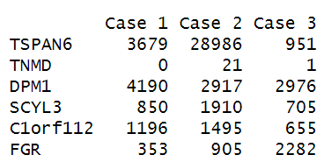
Adam’s work - Step 1 – RNA profile data
Cases (patients)
genes
Raw gene count per case
Notes:
Expression levels are displayed as raw gene counts

Slide 12
Original paper - Step 2 – Identify DEGs
R package edgeR identify differentially expressed genes between cancer and normal tissue
|log FC| > 1.0 , log fold change value indicates overexpression
adjusted P < 0.05, indicates <5% false discovery rate
R package WGCNA builds weighted co-expression networks
Captures both positive and negative correlations between genes
Creates hierarchical tree with branches representing gene modules
Two modules with highest positive correlation in normal and tumor groups selected for further analysis
Notes:
False discovery rate FDR = FP / (FP + TP) = ratio of false positive classifications to total number of positive classifications
Total number of positive classifications includes both false positives and true positives
FDR adapts so that the same number of false positives will have different implications depending on the total number of discoveries
The number of false positives becomes more acceptable if we are also getting a lot more true positives
Gene modules - group of functionally related co-expressed genes, jointly contributes to a cellular phenotype or functional state

Slide 13
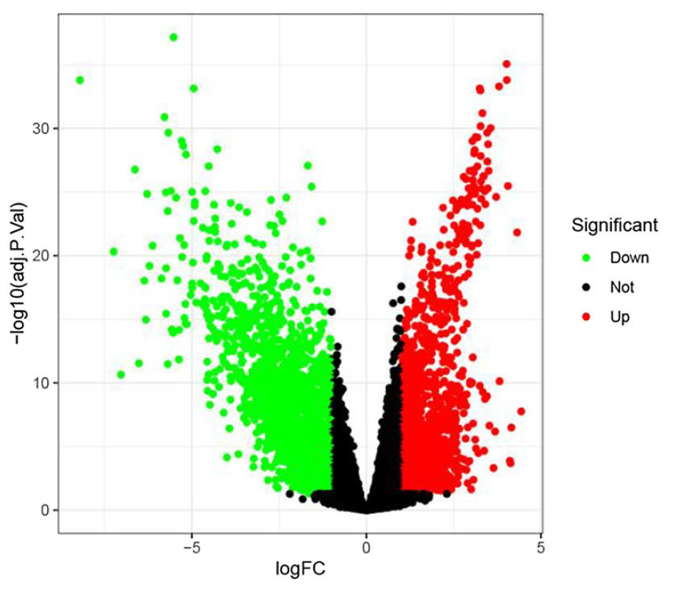
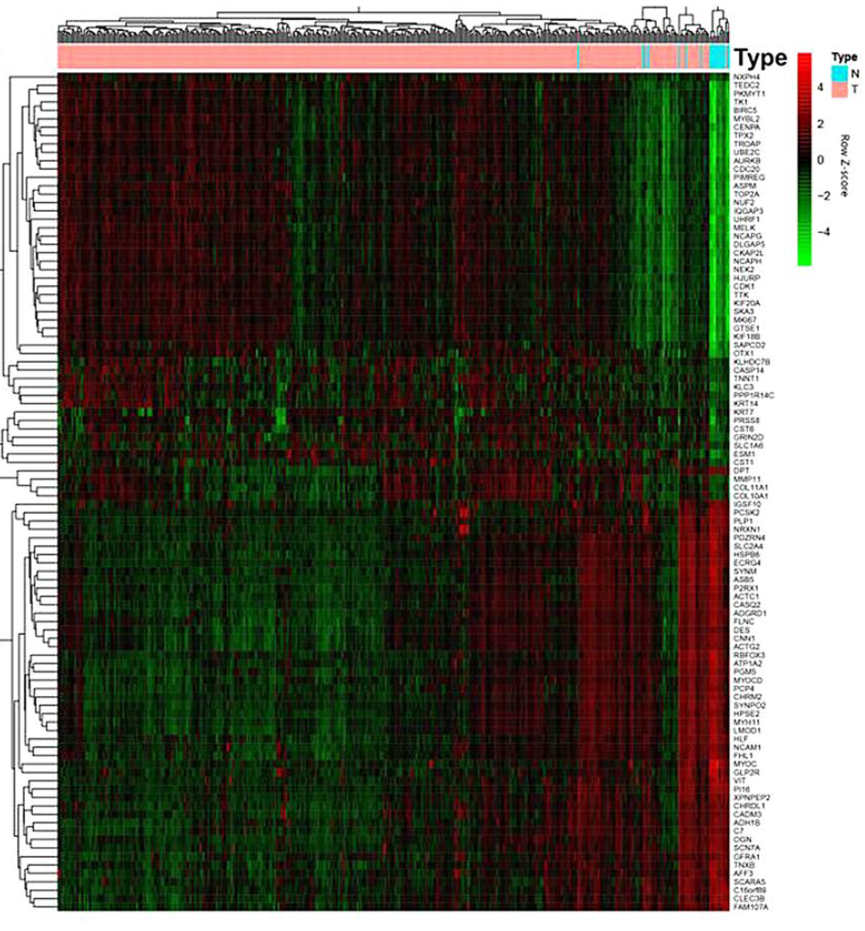
Original paper - Step 2 – Identify DEGs
Notes:
Original results show a separation of genes that contribute up/down towards normal/tissue
Heat map
X axis are the cases – pink are tumor cases while the blue on the far right are the normal cases
Y axis are the genes or groups of genes
Each intersection cell can be dark red to bright green.
Darker red indicates an “up regulator”, over expression of that gene in that particular case is positively correlated
Bright green indicates a “down regulator”, over expression of that gene in that particular case is negatively correlated
Ex – the top left corner shows genes with bright green cells under the normal cases. This indicates that these genes are negatively correlated with normal cases and could be associated with (“causing?”) bladder cancer tumors.
Ex – the bottom right corner shows genes with an up regulator effect on the normal cases. These could be “protective against BC” genes

Slide 14
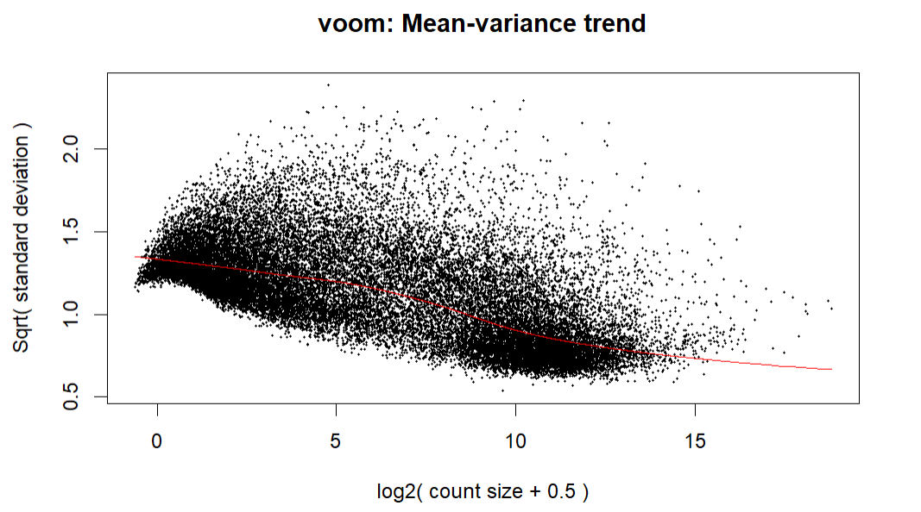
Adam’s work - Step 2 – Identify DEGs
Using R packages edgeR and limma to identify differentially expressed genes between cancer and normal tissue
For now, using:
Voom – prepare data for linear modeling (transform to logCPM)
lmFit – fit data to linear model
eBayes – empirical Bayes moderation of standard errors
elastic net model (alpha = 0.5)
Notes:
Using these tools instead of WGCNA because I am following a TCGA tutorial and I have previous experience with elastic net models
Using an alpha of 0.5 for elastic net. Need to future experiment with alpha = 0 (ridge regression) and alpha = 1 (lasso)
The mean-variance trend plot shows how “the variability of RNA-seq read counts depends on the size of the counts.”
“variability of RNA-seq counts should be a decreasing function of count size for small to moderate counts but for larger counts should asymptote to a value that depends on biological variability.”
This relationship is important because of integer count distribution vs continuous normal distribution
voom: precision weights unlock linear model analysis tools for RNA-seq read counts https://genomebiology.biomedcentral.com/articles/10.1186/gb-2014-15-2-r29

Slide 15
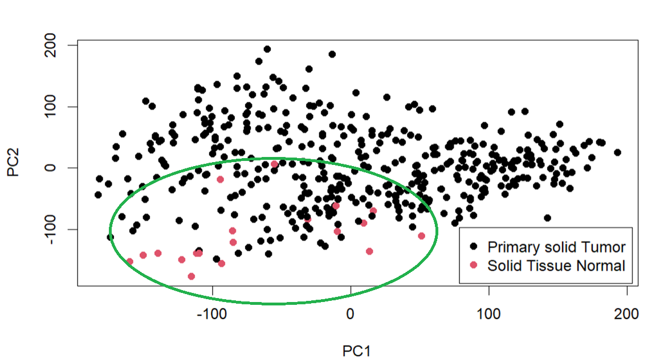
Adam’s work - Step 2 – Identify DEGs – PCA
Notes:
Principal Component Analysis
We do not see a perfect geometric separation, but we clearly see the normal cases are grouped together

Slide 16
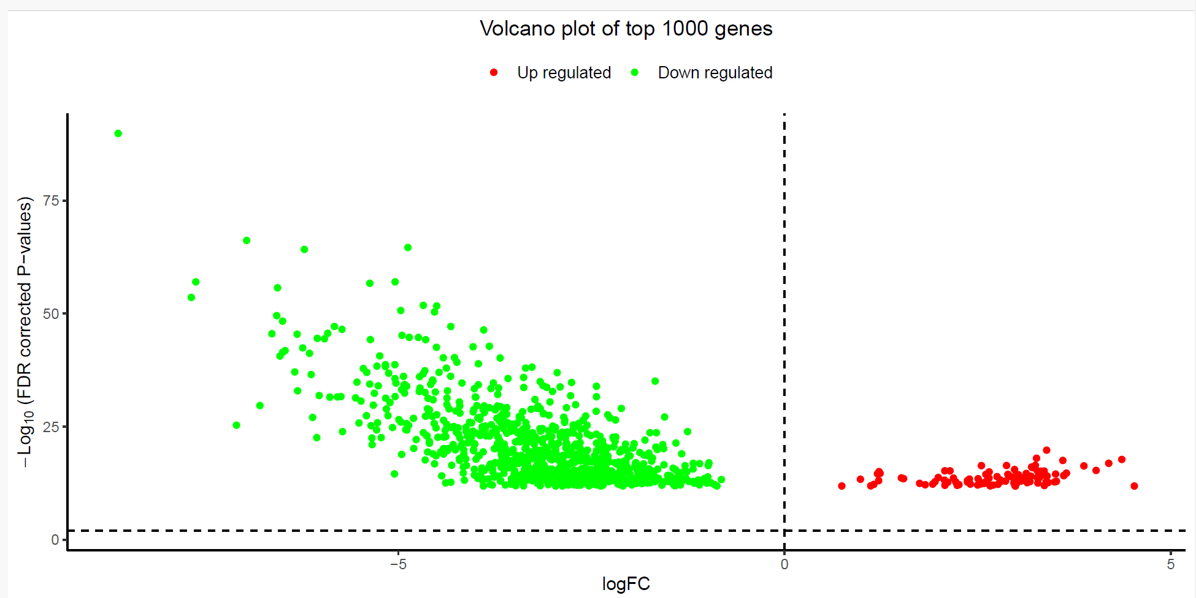
Adam’s work - Step 2 – Identify DEGs – Volcano Plot
Notes:
This shows log fold change vs the adjusted p value
Fold change is a measure of biological relevancy
We have filtered out any log fc between -1 and 1 as no regulatory impact
What does up/down mean in relationship to patient clinical outcome (what impact on cancer?)

Slide 17
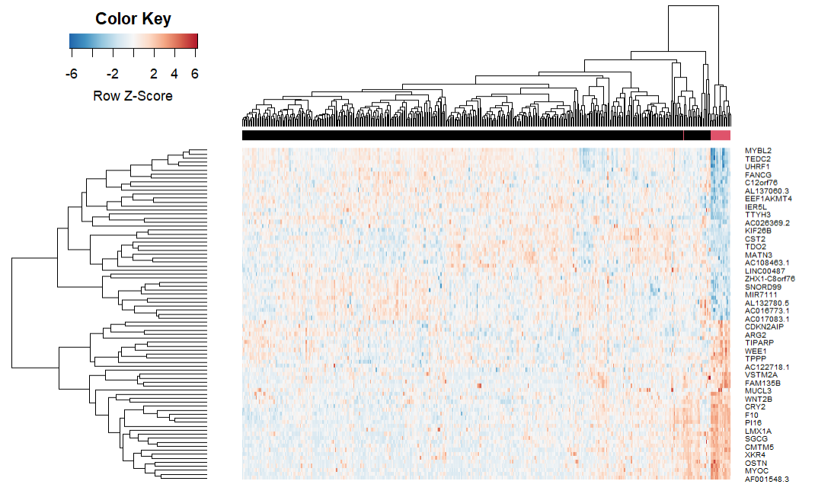
Adam’s work - Step 2 – Identify DEGs - Heatmap
Notes:
https://www.youtube.com/watch?v=Bfx9R5mL2NY&ab_channel=Biostatsquid

Slide 18
Step 2 – Identify DEGs – TCGA Results
Original results:
Using WGCNA, 3461 DEGs identified from TCGA, composed of 7 co-expression gene modules
87 significant genes overlapping between modules and DEGs in clinical groups (11 in normal, 76 in tumor)
Adam’s results:
Initially identified 28,087 genes as potential DEGs after filtering by minimum gene count
Scatter plot of Principal Component Analysis shows geometric grouping of normal cases
Elastic net model training results in identification of 83 significant genes
Overlapping significant genes from both results include PI16, CLEC3B, MYOC (down regulators) and UHRF1 (up regulators)
Notes:
Elastic net is a linear regression method that combines the lasso and ridge methods

Slide 19
Step 3 – Identify DEGs with biological relevance
Normal tissue
TCGA module with r = 0.85, p < 1e-200
GEO module with r = 0.64, p = 9.6e-11
Tumor tissue
TCGA module with r = 0.7, p = 1.7e-95
GEO module with r = 0.49, p = 3.6e-65
11 genes in both normal modules, 76 genes in both tumor modules
Total of 87 overlapping genes used for further analysis
Notes:
r is the Pearson correlation coefficient which measures the linear correlation between two sets of data
Heatmaps and volcano plots used to visualize modules
Venn diagrams used to visualize overlapping genes between modules

Slide 20
Step 3 – Identify DEGs with biological relevance
Gene Ontology (GO) - identifies overrepresented terms in three categories
Biological Process (BP)
Normal – neurotransmitter update, long-term synaptic potentiation, and serotonin transportation
Tumor - nuclear division, sister chromatid segregation, and regulation of chromosome segregation
Molecular Functions (MF)
Normal - SNARE binding and iron ion binding
Tumor - ATPase activity and 3′ to 5′ DNA helicase activity
Cellular Components (CC)
Normal – growth cone and site of polarized growth
Tumor – chromosomal regions, condensed chromosomes, centromeric regions, and condensed chromosome kinetochores
Notes:
Functional annotation of 87 overlapping DEGs
GO signifys biological relevance of genes
SNARE binding - soluble N-ethylmaleimide sensitive factor attachment protein receptor

Slide 21
Step 3 – Identify DEGs with biological relevance
Kyoto Encyclopedia of Genes and Genomes (KEGG)
pathway enrichment analyses…connects genomes and biological processes
Normal genes - arachidonic acid metabolism and synaptic vesicle cycle
Tumor genes - mitotic nuclear division, regulation of mitotic nuclear division, and metaphase/anaphase transition of the mitotic cell cycle
Notes:
KEGG integrates genomic, chemical, and systematic functional information to connect genomes and biological processes

Slide 22
Adam’s work - Step 3 – Identify DEGs with biological relevance
83 DEGs initially identified…after filtering by logFC > |1| only 12 remain
Six up regulators - ESM1, OTX1, KIF18B, UBE2C, TROAP, NEK2
These are associated with endothelial cells, transcription factors, and cellular mechanisms for targeting abnormal proteins
GO Ontology does not give any results with significance p_{adjusted} < 0.5
Six down regulators - MBD5, PPP3CB, CALCOCO1, MOAP1, CA5B, RAP1A
These are associated with calcium binding and cellular apoptosis
GO Ontology gives several results around p_{adjusted} of 0.5, but they are rather generic entries related to cellular activities

Slide 23
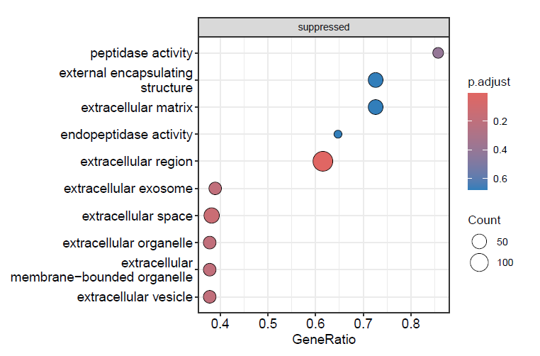
Adam’s work - Step 3 – Identify DEGs with biological relevance
Down regulator GO Ontology results

Slide 24
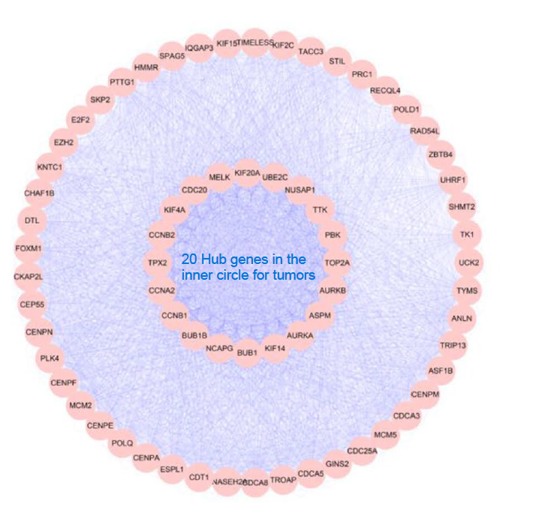
Step 4 – Visualize hub gene interaction networks
Protein-Protein Interactions (PPI) network constructed using STRING for the tumor group of 78 genes shows a subgroup of 20 hub genes…
Notes:
STRING is Search Tool for the Retrieval of Interacting Genes/Proteins
PPI are physical contacts between protein molecules as a result of biochemical events

Slide 25
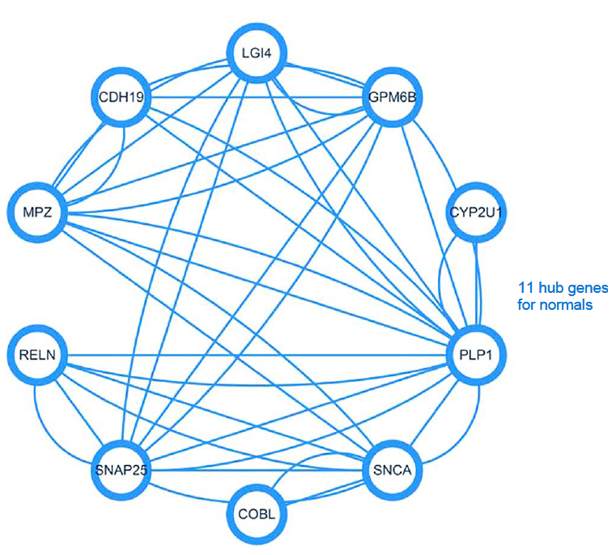
Step 4 – Visualize hub gene interaction networks
…while the normal group shows all 11 genes interacting without any subgroup of hub genes
Notes:
STRING is Search Tool for the Retrieval of Interacting Genes/Proteins
PPI are physical contacts between protein molecules as a result of biochemical events

Slide 26
Adam’s work - Step 4 – Visualize hub gene interaction networks
Need to continue and improve implementing WGCNA…
Completed - Identify gene modules (groups of co-expressed genes)
TBD - Reduce gene modules to only most significant genes
TBD - Identify hub genes that cross modules

Slide 27
Original paper - Step 5 - Prognostic value of hub genes
After PPI visualization...
20 hub genes from tumor tissue, 11 genes from normal tissue
Use of R survival package finds…
9 genes associated with BC prognosis
4 genes significantly associated – CDH19, RELN, PLP1, and TRIB3
All genes also associated with clinical stage of BC
CDH19, RELN, and PLP1 levels higher in normal tissue than tumor tissue
TRIB3 higher in tumor tissue than normal tissue (some contrary evidence found in Human Protein Atlas)

Slide 28
Adam’s work - Step 5 - Prognostic value of hub genes
TBD - Make use of the R survivor package to…
Identify hub genes and other DEGs associated with prognosis
Consider impact of patient age, age at diagnosis, age of death, tumor stage at diagnosis, treatment, and other relevant factors included with the TCGA bladder cancer data
Consider association with tumor stage and gene expression levels. How does the gene expression change over time?

Slide 29

Additional work…
Finish implementing Steps 4 (hub gene networks) and 5 (prognosis)
Evaluate model testing results (confusion matrix)
Finish implementation of WGCNA…reduce number of gene modules
Implement GEO data?
Experiment with varying alpha value in elastic net model (0 for ridge regression, 1 for lasso)
Get better GO results that closer match original paper
Incorporate multi threading into GO step
Incorporate AI tools

Slide 30
References
Wang, H., Liu, J., Lou, Y. et al. Identification and preliminary analysis of hub genes associated with bladder cancer progression by comprehensive bioinformatics analysis. Sci Rep 14, 2782 (2024). https://doi.org/10.1038/s41598-024-53265-z
Manolov & Maei. Analysis of Cancer Genome in R. https://www.costalab.org/wp-content/uploads/2020/11/R_class_D3.html.
Chang, Jennifer. Network analysis with WGCNA. WGCNA Gene Correlation Network Analysis. https://bioinformaticsworkbook.org/tutorials/wgcna.html#gsc.tab=0

